Slide 1




Deep Learning-Based PET Image Correction Toward Quantitative Imaging
Presenter: Sama Shahpouri
Study : Data Science for Life Science
Institute: Hanze University of Applied Sciences, Institute of Life Science & Technology
Supervisors: Dr. Isaac Shiri, Dr. Dave Landers, Dr. Gijs van der Schot
28/08/2024

Slide 2
Introduction of PET & ASC Problem Statement Research Objective Data Collection Methodology Internal Validation Results External Validation Results Artifact Correction Results Conclusion
Agenda

Slide 3
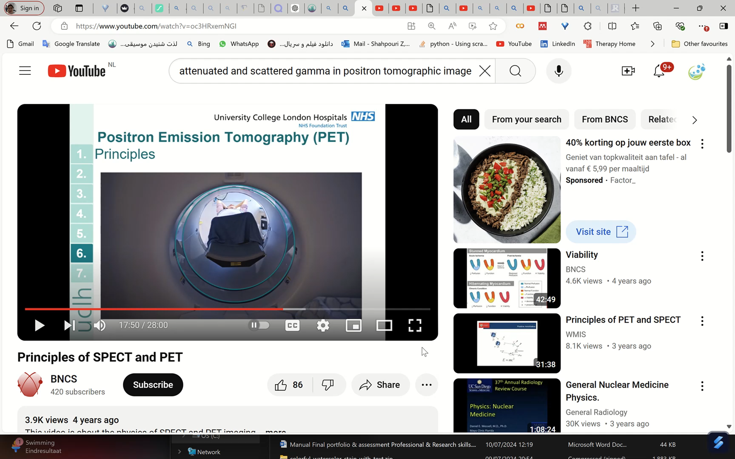
PET & Attenuation / Scatter
https://youtu.be/oc3HRxemNGI?si=djrXXO1kcawsbd8_

Slide 4
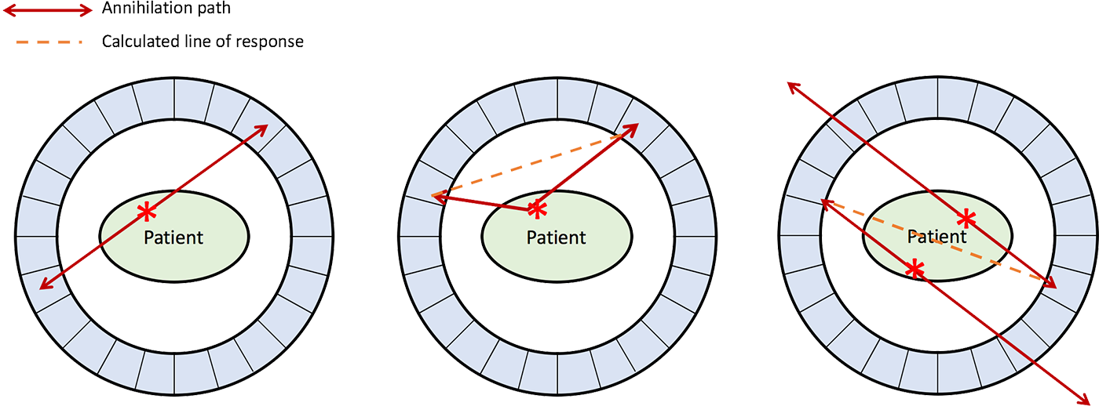
PET Attenuation and Scatter Correction (ASC)
Attenuation correction (AC) of annihilation photons along lines of response (LOR) in the patient body is another critical step
Scatter correction (SC) of Compton scattered photons, which can result in mis-allocation of the annihilated photons, is crucial
True Coincidence
One annihilation
Straight path photons
Scatter Coincidence
One annihilation
Photons scatter
Artifactual measured LOR
Random Coincidence
More than one annihilation
Photons from different annihilations are detected simultaneously
Artifactual measured LOR
https://www.radiologycafe.com/frcr-physics-notes/molecular-imaging/pet-imaging/

Slide 5
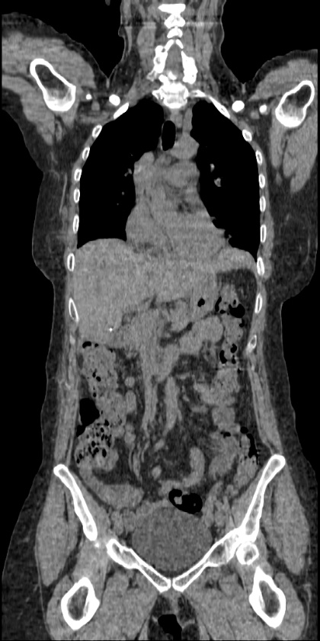
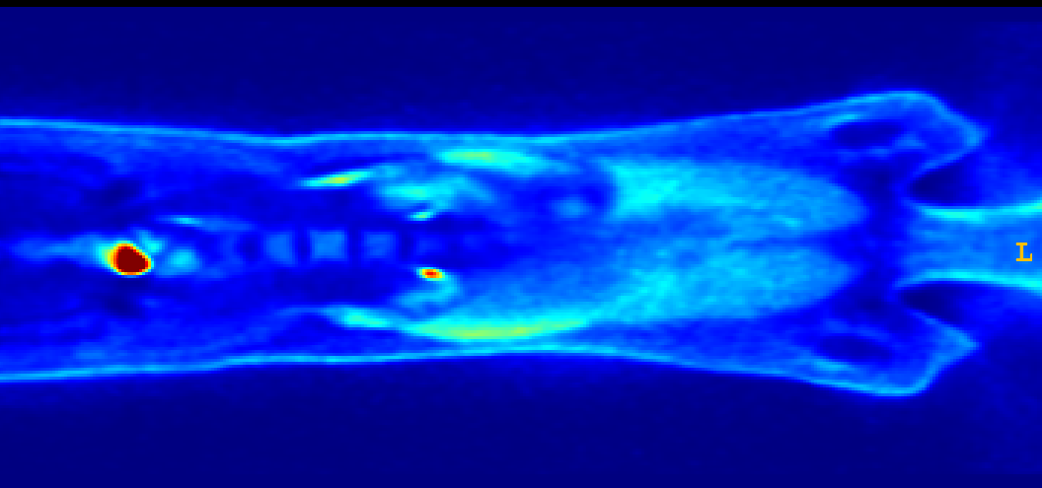
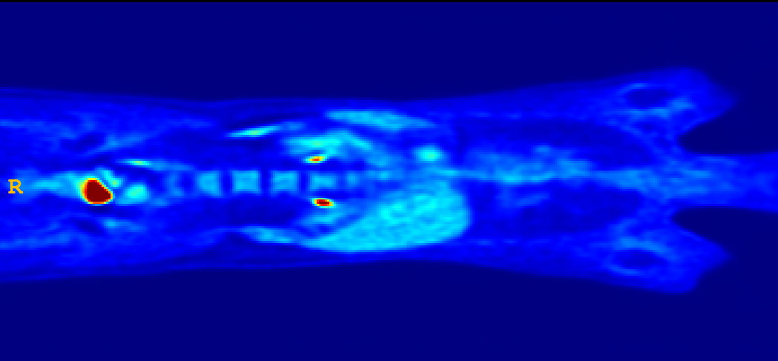
Effects of Attenuation Scatter Correction
Reduced mediastinal
uptake
'Hot' lungs
Non-uniform liver
Enhanced skin uptake
The non-attenuation corrected image (NAC) PET: with ASC (accurate) CT image (accur

Slide 6
CT Image
X-ray acquisition
Anatomical (CT) Reconstruction
Smooth to PET Resolution
Translate CT to PET Energy (511 keV)
PET Image
PET Emission Acquisition
Attenuation/Scatter Correct PET Emission Data
Functional (PET) Reconstruction
Data flow in a PET/CT scanner [1]

Slide 7
Challenges in ASC using CT info
☢️Radiation Exposure
⚠️CT Artifacts Impact PET Data
🔄Misalignment Issues
🛠️Metal Artifacts
🌬️Respiratory Pattern Differences
🚫Limited Availability
💰Cost and Complexity
💉Contrast Agent Issues
✂️CT Truncation Effects
🔦CT Bias Due to Beam-Hardening

Slide 8
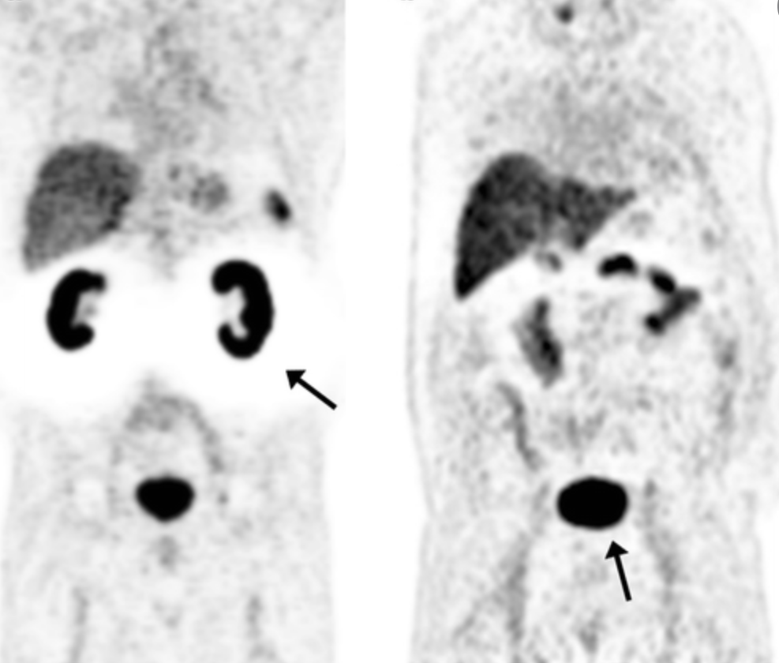
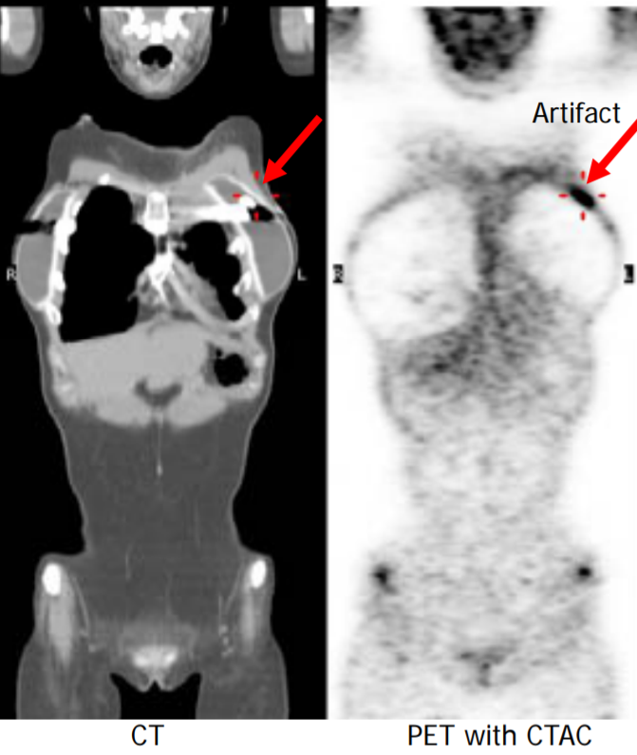
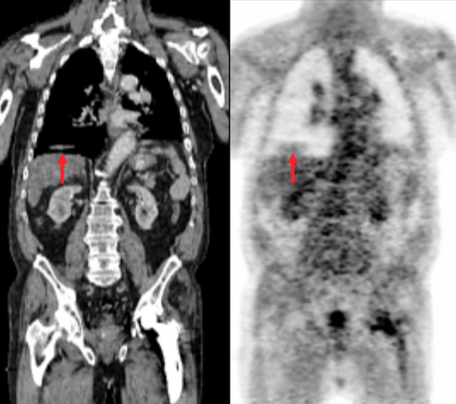
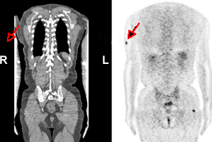
Halo;
Metal;
Motion;
Truncation;
Types of common Artifacts

Slide 9
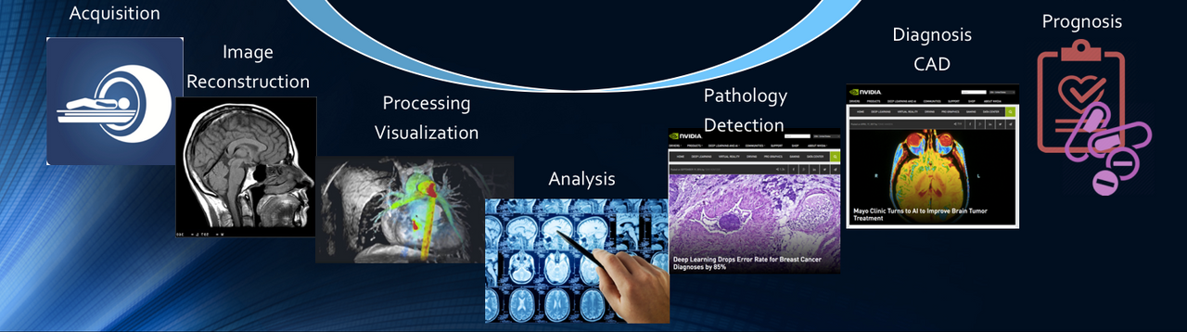
https://subtlemedical.com/ai-is-starting-to-change-radiology-for-real/
AI is starting to change medical imaging, for real
1990s: Early experiments with machine learning techniques for image reconstruction and basic attenuation correction in PET [2]
2010s: Initial research and exploration of AI for enhancing medical imaging and ASC (Indirect approaches )
Early 2020s : Advanced deep learning models are introduced for direct scatter correction, eliminating the need for separate correction steps and improving workflow efficiency [2]
2022-2023: Wider clinical integration and validation of AI-based ASC methods, enhancing image quality and diagnostic accuracy.

Slide 10
⇓Research Objective
✔️ Address direct ASC of PET images without CT anatomical data
✔️ Create a universal model applicable to different radiotracers and scanners ✔️ Evaluate model performance in artifact removal across a multi-center dataset

Slide 11
Materials and Methods

Slide 12
Workflow of A CT-less deep convolutional neural network
PET raw data
CT images
Recon without AC & SC
Recon with AC & SC
Recon : reconstruction;
AC : attenuation correction,
SC : scatter correction,
NAC : non-corrected PET,
MAC : CT-Measured attenuation/scatter corrected,
DL PET : deep learning–corrected PET,
NAC (Input)
MAC (Target)
Model Training
DL PET

Slide 13
Workflow of Decomposition-Based Approach [3]
PET raw data
CT images
Recon without AC & SC
Recon with AC & SC
NAC (Input)
MAC (Target)
Model Training
DL PET

Slide 14
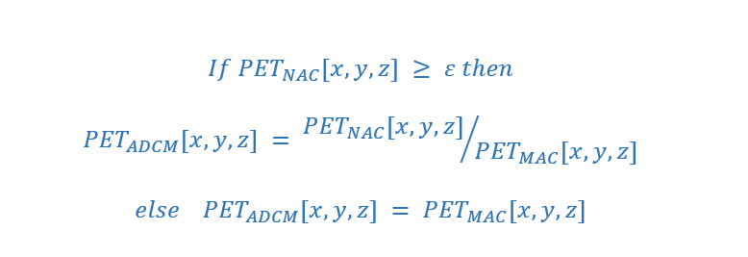
Workflow of Decomposition-Based Approach [1]
NAC (Input)
MAC (Target)
Anatomy-Dependent Correction Maps (ADCM)
Model Training
Anatomy-independent textures
DL PET
[2] Guo R, Xue S, Hu J, Sari H, Mingels C, Zeimpekis K, et al. Using domain knowledge for robust and generalizable deep
learning-based CT-free PET attenuation and scatter correction. Nat Commun. 2022 Dec 1;13(1).

Slide 15
Workflow of Decomposition-Based Approach [1]
NAC (Input)
ADCM
Anatomy-Dependent Correction Maps (ADCM)
Model Training
Anatomy-independent textures
DL PET
[2] Guo R, Xue S, Hu J, Sari H, Mingels C, Zeimpekis K, et al. Using domain knowledge for robust and generalizable deep
learning-based CT-free PET attenuation and scatter correction. Nat Commun. 2022 Dec 1;13(1).

Slide 16
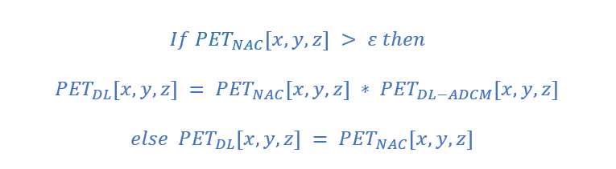
Workflow of Decomposition-Based Approach [1]
NAC (Input)
ADCM
Model Training
DL ADCM
DL PET
[2] Guo R, Xue S, Hu J, Sari H, Mingels C, Zeimpekis K, et al. Using domain knowledge for robust and generalizable deep
learning-based CT-free PET attenuation and scatter correction. Nat Commun. 2022 Dec 1;13(1).

Slide 17
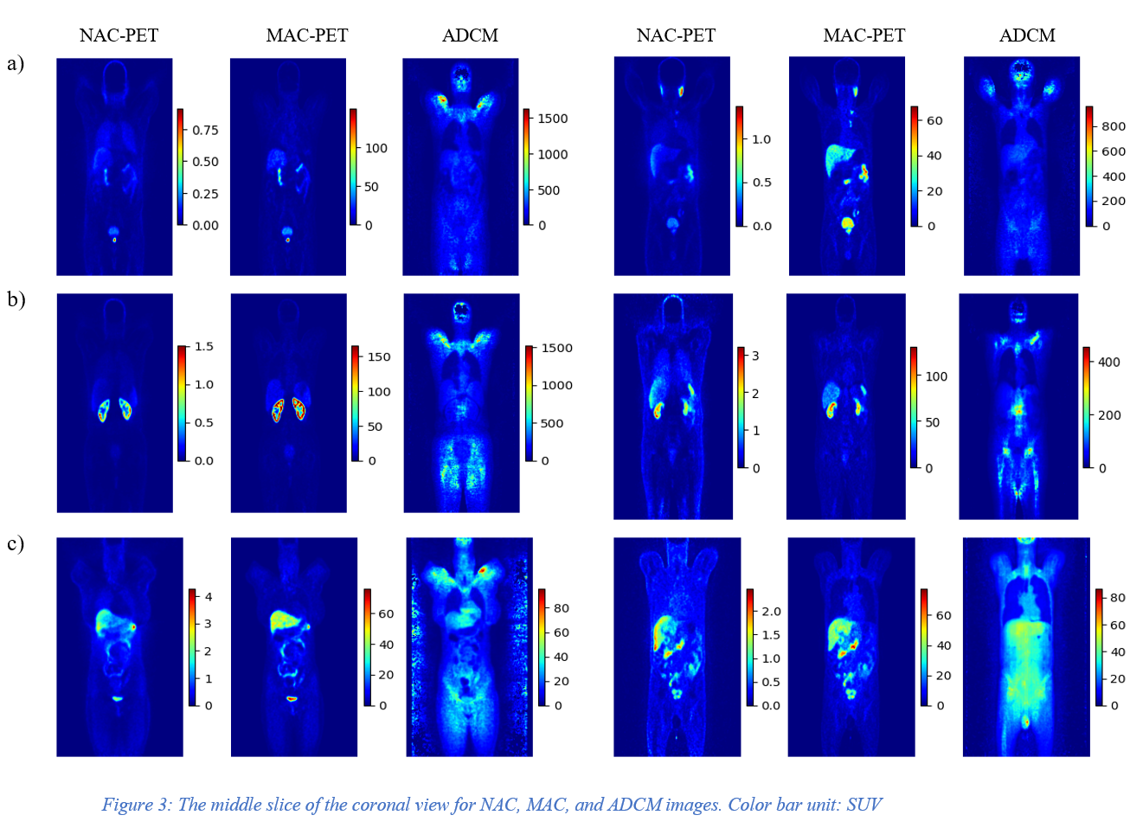

Slide 18
Center | No | Train | Validation | Test | Scanner | Reconstruction | Matrix size × Z*
Center 1 | 56 | 43 | 11 | 2 | Siemens Biograph 6 | 3D-OSEM | 168 × 168
Center 2 | 31 | 25 | 4 | 2 | GE Discovery IQ | 3D-OSEM | 192 × 192
Center 3 | 45 | 35 | 8 | 2 | Siemens mCT | 3D-OSEM | 200 × 200
Center 4 | 40 | 28 | 10 | 2 | Siemens Biograph 6 | 3D-OSEM | 168 × 168
External Center | 12 | - | - | 12 | Siemens Horizon | PSF+TOF+3D-OSEM | 180 × 180
Total | 184 | 131 | 33 | 20 | - | - | -
* Z representing the number of slices in the axial view, depends on body length, scanner resolution, scan protocol, and patient positioning. Therefore, it varies for each patient.
⁶⁸Ga PET/CT Dataset [4]

Slide 19
¹⁸F-FDG Dataset [5]
Center | No | Train | Validation | Test | Scanner | Reconstruction | Matrix size × Z*
Center 6 | 55 | 39 | 6 | 11 | Siemens Biograph 6 | 3D-OSEM | 168 × 168
Center 7 | 43 | 23 | 9 | 10 | GE Discovery IQ | 3D-OSEM | 192 × 192
Total | 98 | 62 | 15 | 21 | - | - | -
* Z representing the number of slices in the axial view, depends on body length, scanner resolution, scan protocol, and patient positioning. Therefore, it varies for each patient.

Slide 20
190 patients ¹⁸Ga PSMA PET/CT Motion and Halo artifacts
Artifact dataset

Slide 21
Test Sets
Internal Center, External Center: : 5% of 4 centers of Ga dataset + total data of the 5th centers of Ga dataset
External Tracer (FDG): 10% of 2 centers FDG dataset
Artifact images: All of the dataset

Slide 22
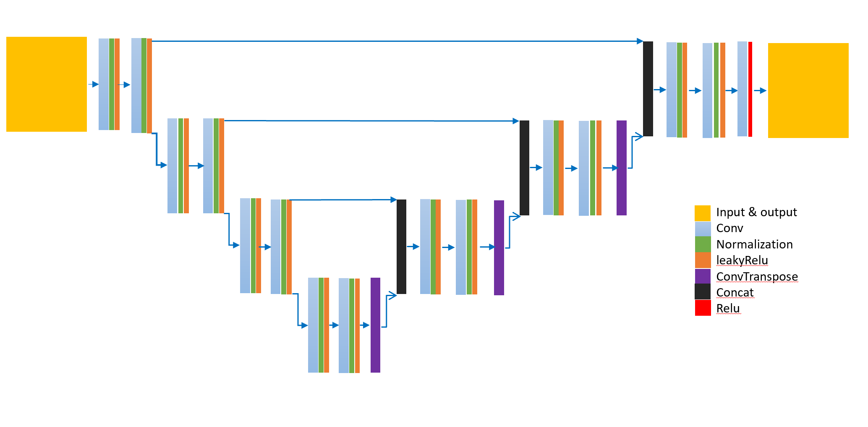
Hyper parameters
Dyn-UNet architecture
3D patches sized 168×168×16
20 patches per patient
Loss function of the mean squared error (MSE)
Learning rate of 0.001
Optimization Adam algorithm
Batch size: 4
spacing : [4.07, 4.07, 3.00]
four layers: [16, 32, 64, 128]
Kernels: [3, 3, 3]
2 super vision head
The architecture of DynUnet

Slide 23
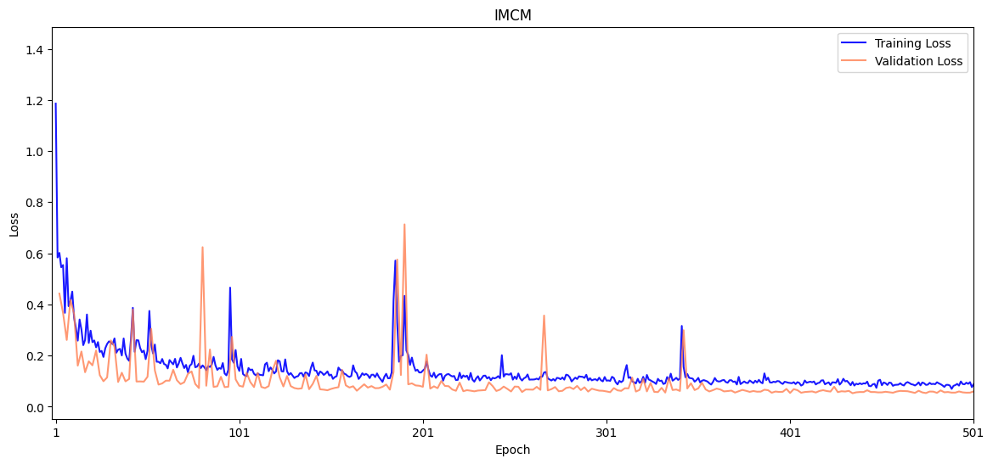
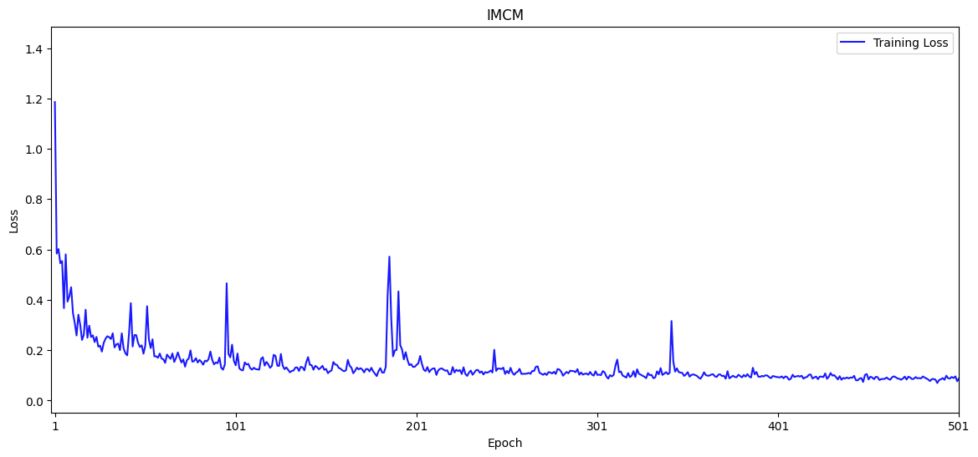
⁶⁸Ga-PET
Integrated multi-Centre model (IMCM): the best metric of 0.0527 at epoch 434.

Slide 24
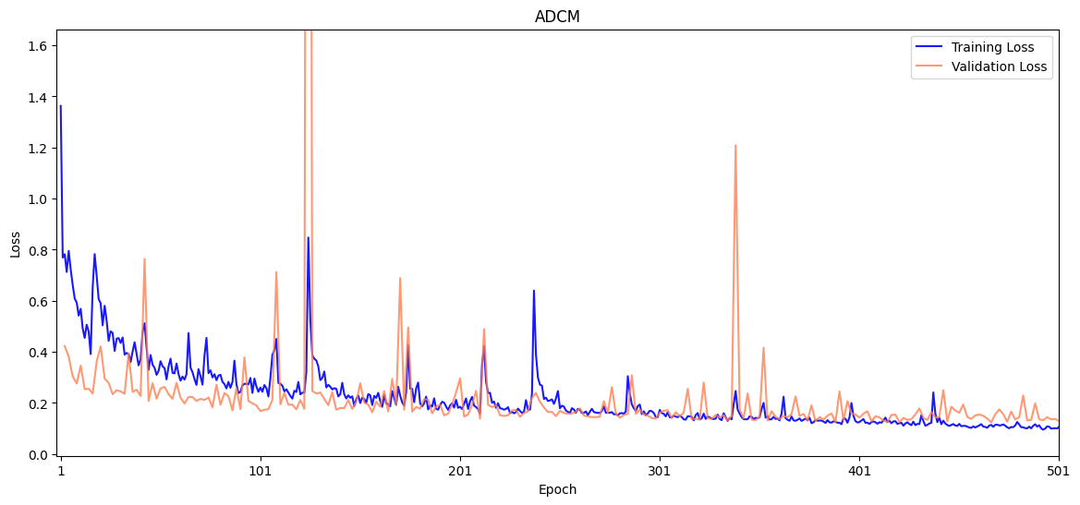
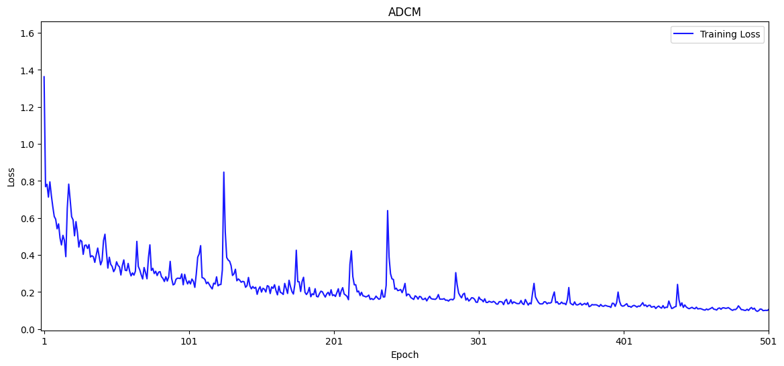
⁶⁸Ga-PET
Anatomy-Dependent Correction Model (ADCM): the best metric of 0.1237 was reached at epoch 466.

Slide 25
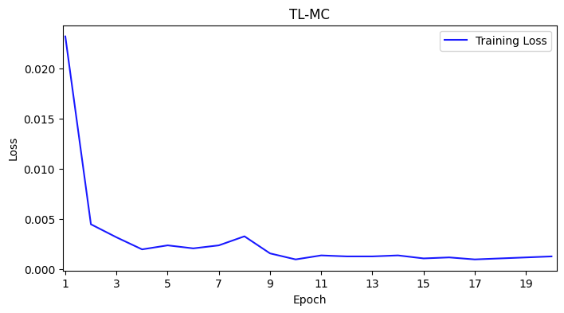
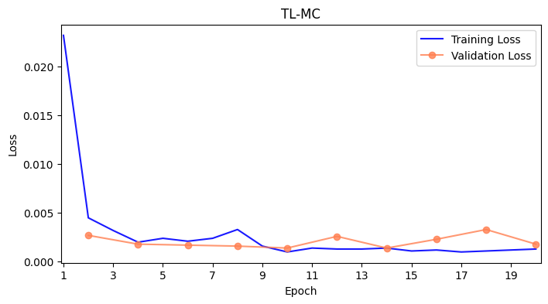
¹⁸F-FDG
Transfer Learning for IMCM model (TL-MC):

Slide 26
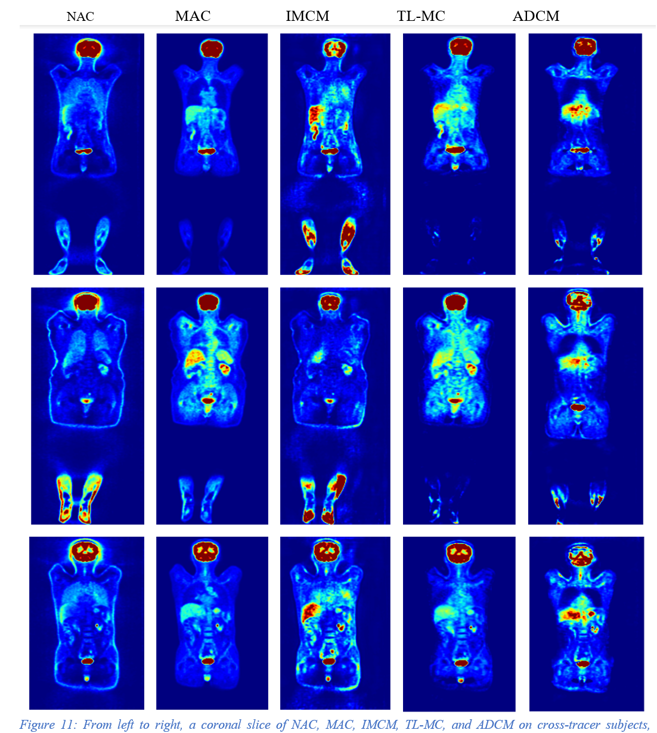
¹⁸F-FDG

Slide 27
Results

Slide 28
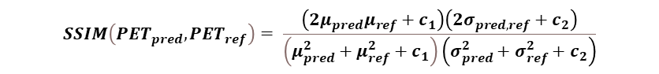
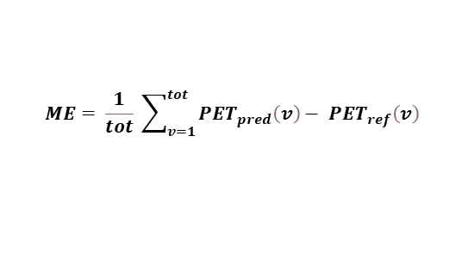
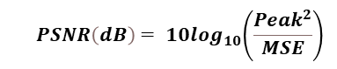
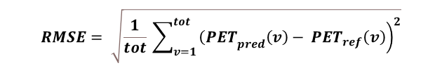
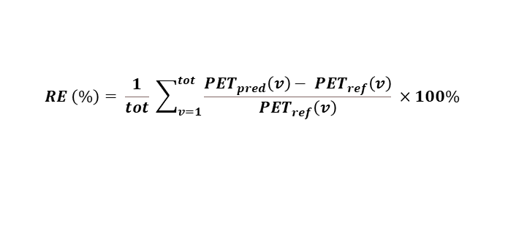
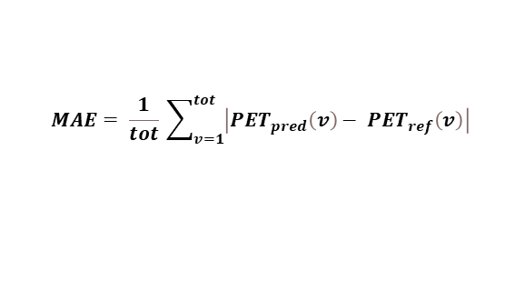
Cross-Center
$$ME= \frac{1}{tot} \sum_{v=1}^{tot}{{PET}_{pred}\left(v\right)− {PET}_{ref}\left(v\right) }$$
$$MAE= \frac{1}{tot} \sum_{v=1}^{tot}{\left|{PET}_{pred}\left(v\right)− {PET}_{ref}\left(v\right)\right| }$$
$$RE \left(\%\right)= \frac{1}{tot} \sum_{v=1}^{tot}{\frac{{PET}_{pred}\left(v\right)− {PET}_{ref}\left(v\right)}{{PET}_{ref}\left(v\right)} ×100\% }$$
$$RMSE= \sqrt{\frac{1}{tot} \sum_{v=1}^{tot}{{\left.{\left(PET\right.}_{pred}\left(v\right)− {PET}_{ref}\left(v\right)\right)}^{2}}}$$
$${ PSNR\left(dB\right)= 10log}_{10}\left(\frac{{Peak}^{2}}{MSE}\right)$$
⁶⁸Ga-PET
$$SSIM\left({PET}_{pred},{PET}_{ref}\right)= \frac{\left(2μ_{pred}μ_{ref}+c_{1}\right)\left(2σ_{pred,ref}+c_{2}\right)}{\left(μ_{pred}^{2}+μ_{ref}^{2}+c_{1}\right)\left(σ_{pred}^{2}+σ_{ref}^{2}+c_{2}\right)}$$

Slide 29
Cross-Center
⁶⁸Ga-PET

Slide 30
Cross-Tracer
¹⁸F-FDG

Slide 31
Cross-Tracer
¹⁸F-FDG

Slide 32
Case Study on artifact images

Slide 33
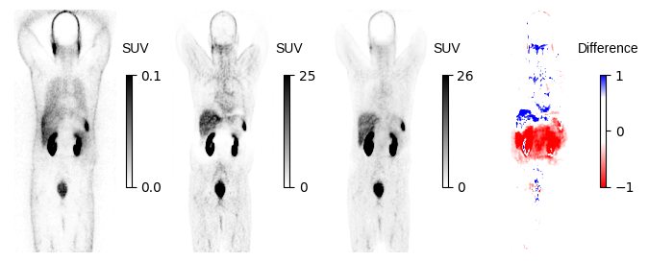
Halo artifact in kidney

Slide 34
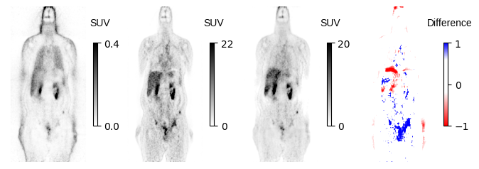
Motion Artifact

Slide 35
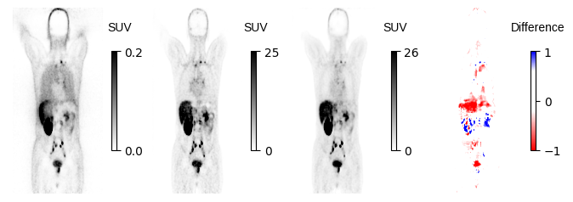
Motion Artifact

Slide 36
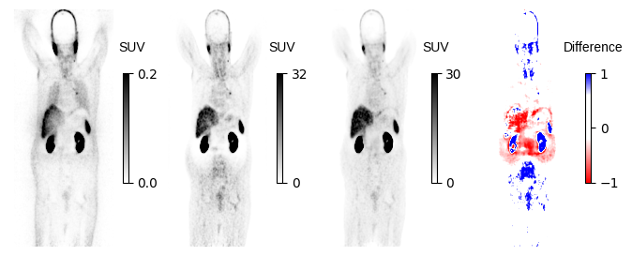
Motion and Halo

Slide 37
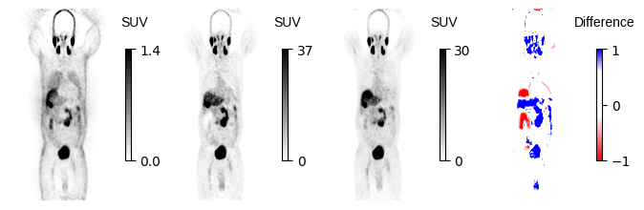

Slide 38
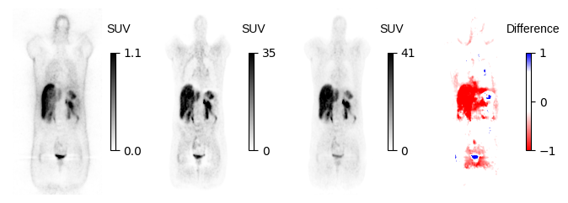
Halo

Slide 39
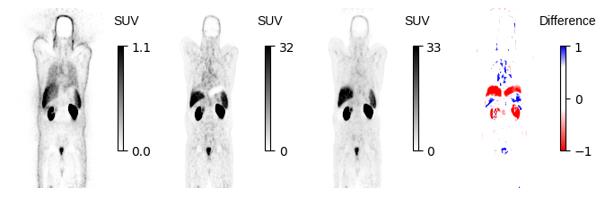
Motion artifact

Slide 40
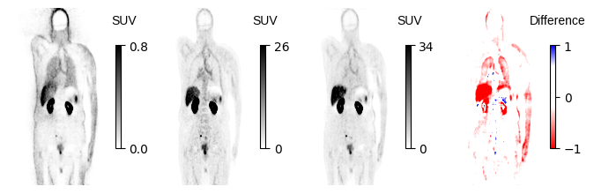
Truncation and Motion

Slide 41
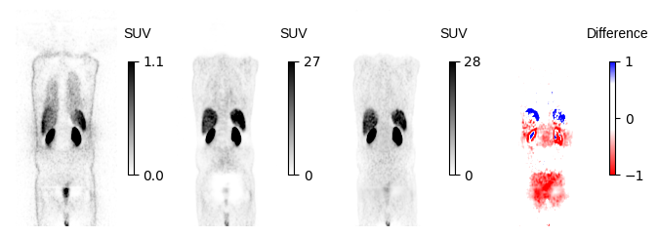
Halo artifact

Slide 42
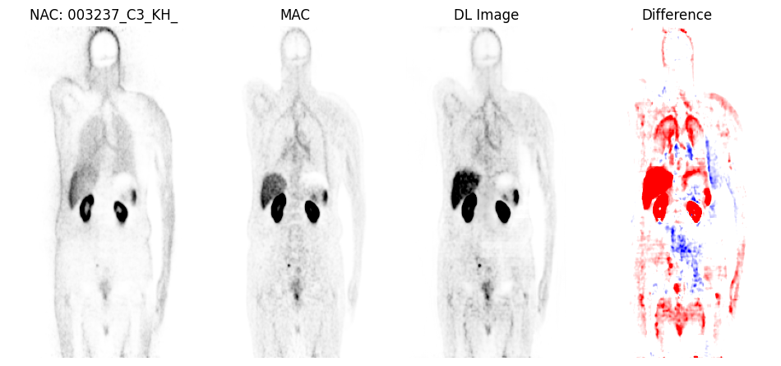
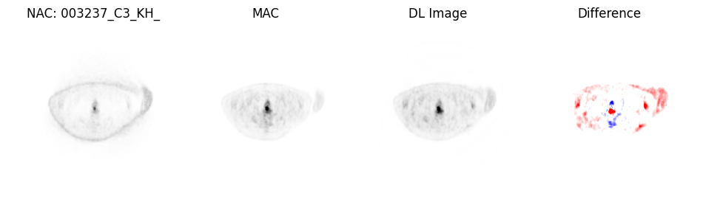
Truncation Artifact

Slide 43
Discussion

Slide 44
Discussion
🗨️ Developed a CT-free DL models for ASC in PET imaging, tested across different centers and radiotracers.
🗨️ IMCM showed significant improvement in quantitative accuracy and artifact correction.
🗨️ IMCM outperformed ADCM, demonstrated more reliable and consistent performance in SUV estimations.
🗨️ Using large, heterogeneous datasets enhances the generalizability and applicability of ASC models in PET imaging. These diverse datasets ensure the model performs well on unseen data, making it robust and reliable for real-world clinical settings.

Slide 45
Conclusion

Slide 46
Conclusion
🔍 Designed a network to directly performs ASC from raw data. This approach is less vulnerable to the challenges of pseudo-CT synthesis.
🔍 Preformed well in different centers, making it reliable and flexible for use in clinics.
🔍 Addressed the artifact challenges, high capability in detecting and removing artifacts in PET scans.
🔍 Constructed and validated a highly effective and fast quality assurance method to not only detect but to also overcome those artifacts.
🔍 Be applicable where only Stand-alone PET or PET/MRI systems are available.

Slide 47
Limitations

Slide 48
Limitations
🧱 Models optimized for one radiotracer type may not perform well with others, necessitating tracer-specific tuning.
🧱 Single universal models may not be effective; radioisotope-specific tuning is necessary.
🧱 Limited access to computational servers caused each training loop to take excessive time.

Slide 49
Future Work

Slide 50
Future Work
📍 Explore more Clinical Imaging Parameters: SUVmean, SUVmax, and total lesion metabolism.
📍 Assess the model organ-wise.
📍 Targeted analysis for clean and artifactual images.
📍 Rigorous statistical testing of categorized outcomes.
📍 Investigate Alternative Neural Networks generative adversarial networks (GANs), variational autoencoders, transformer-based models, or Swin-UNet.
📍 Experiment with other optimizers like AdamW, RMSprop, and Nadam.
Test model performance on data from other centers.

Slide 51
[1] Schmitz et al. The physics of PET/Ct scanners. PET and PET/CT: a clinical guide, 2005. [2] Chen, X., Liu, C. Deep-learning-based methods of attenuation correction for SPECT and PET. J. Nucl. Cardiol. 30, 1859–1878 (2023). https://doi.org/10.1007/s12350-022-03007-3 [3] [2] Guo R, Xue S, Hu J, Sari H, Mingels C, Zeimpekis K, et al. Using domain knowledge for robust and generalizable deep learning-based CT-free PET attenuation and scatter correction. Nat Commun. 2022 Dec 1;13(1). [4] Shiri I, Salimi Y, Hervier E, Pezzoni A, Sanaat A, Mostafaei S, et al. Artificial Intelligence-Driven Single-Shot PET Image Artifact Detection and Disentanglement: Toward Routine Clinical Image Quality Assurance. Clin Nucl Med. 2023 Dec 1;48(12):1035–46 [5] Shiri I, Salimi Y, Hervier E, Pezzoni A, Sanaat A, Mostafaei S, et al. Artificial Intelligence-Driven Single-Shot PET Image Artifact Detection and Disentanglement: Toward Routine Clinical Image Quality Assurance. Clin Nucl Med. 2023 Dec 1;48(12):1035–46.
References

Slide 52


Slide 53
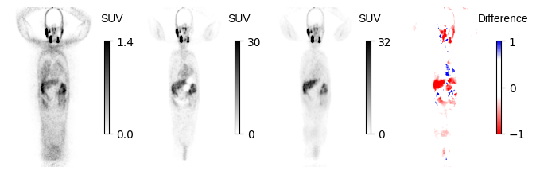
Metal artifact

Slide 54
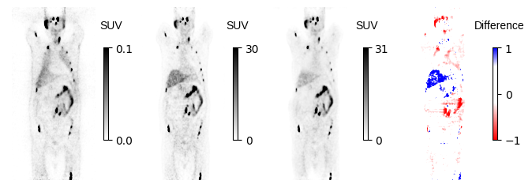
Motion Artifact???

Slide 55
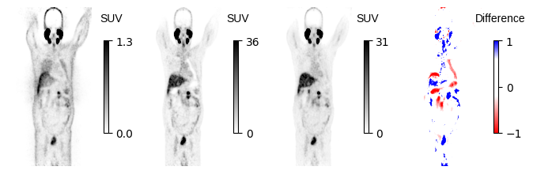
???

Slide 56
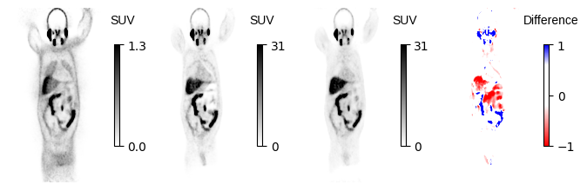
??

Slide 57
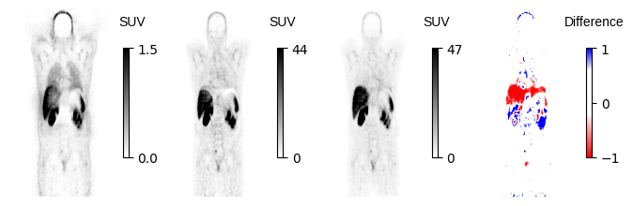

Slide 58
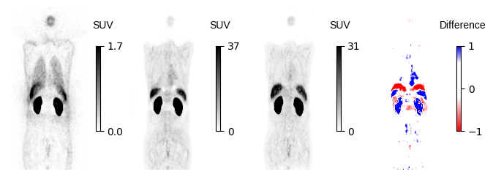

Slide 59
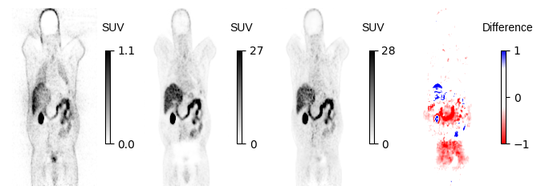

Slide 60
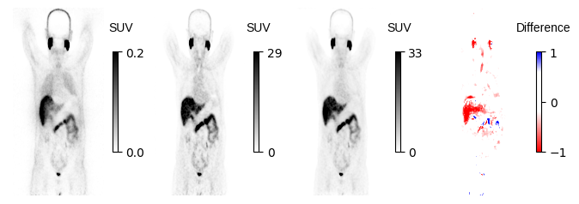

Slide 61
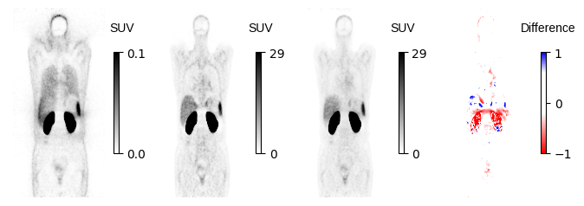

Slide 62
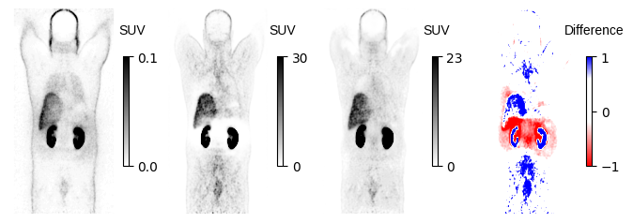

Slide 63
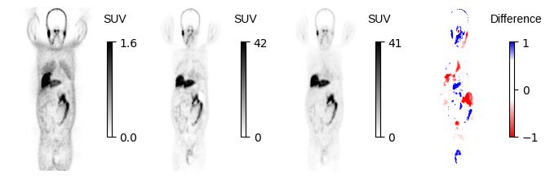

Slide 64
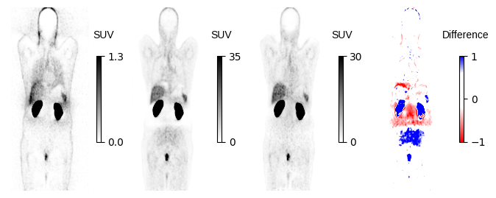

Slide 65

Halo under the liver

Slide 66


Slide 67
⁶⁸Ga-Artifact

Slide 68
⁶⁸Ga-Artifact
Coronal views of 6 clinical studies, representing from left to right: NAC, MAC, IMCM-DL and the difference images of MAC and DL image. Our method effectively disentangles halo artefacts in the kidney area.

Slide 69
⁶⁸Ga-Artifact
Coronal views, showing from left to right NAC, MAC, IMCM-DL and the difference images of MAC and DL image. The images generated using the IMCM approach successfully corrected the mismatch artefact in the diaphragm, lung, liver and spleen regions.

Slide 70

⁶⁸Ga-Artifact

